Slide 1


Electric Circuits
Twelfth Edition, Global Edition
Chapter 9 – Part 2
Sinusoidal Steady-State Analysis
© 2024 Pearson Education Ltd. All Rights Reserved
Notes:
If this PowerPoint presentation contains mathematical equations, you may need to check that your computer has the following installed:
1) Math Type Plugin
2) Math Player (free versions available)
3) NVDA Reader (free versions available)

Slide 2
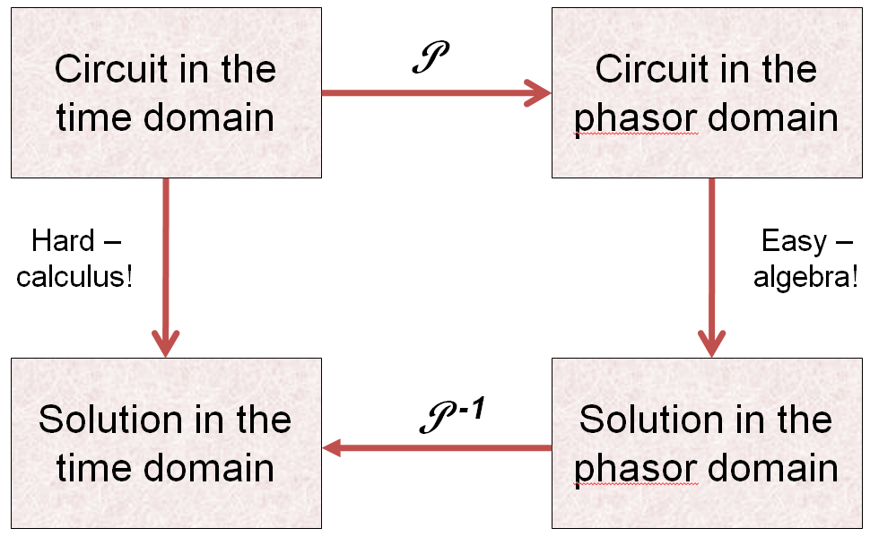
Chapter 9 – Sinusoidal Steady-State Analysis (1 of 17)

Slide 3
Chapter 9 – Sinusoidal Steady-State Analysis (2 of 17)
Steps in A C S S Analysis:
Redraw the circuit (the phasor transform does not change the components or their connections).
Phasor transform all known v(t) and i(t).
Represent unknown voltages and currents with V and I.
Replace component values with impedance (Z) values.
Use any circuit analysis method(s) to write equations and solve them with a calculator.
Inverse-transform the result, which is a phasor, back to the time domain.

Slide 4
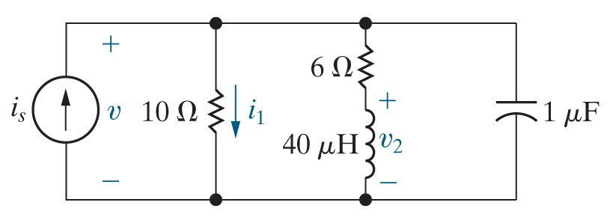



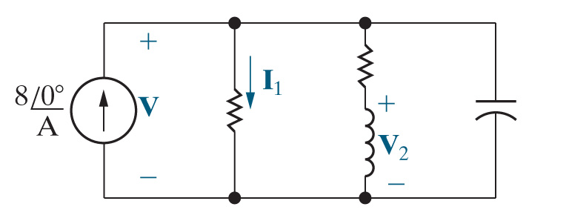
Chapter 9 – Sinusoidal Steady-State Analysis (3 of 17)
Example:
Find v(t),
and
in the
steady-state.
Redraw the circuit.
Phasor transform all known voltages and currents.
Represent unknown voltages and currents with phasor symbols

Slide 5


Chapter 9 – Sinusoidal Steady-State Analysis (4 of 17)
The next step is to calculate the impedance of all resistors, inductors, and capacitors. Actually, the impedance of the resistors doesn’t require calculation.
A. True
B. False

Slide 6
Chapter 9 – Sinusoidal Steady-State Analysis (5 of 17)
The impedance of inductors and capacitors is calculated using
A. The source frequency
B. The component value
C. Both A and B

Slide 7
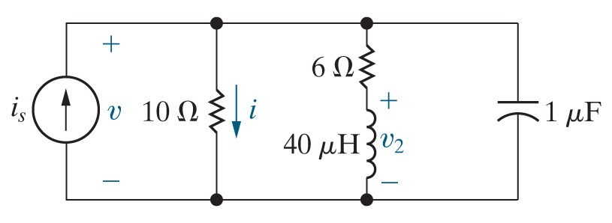
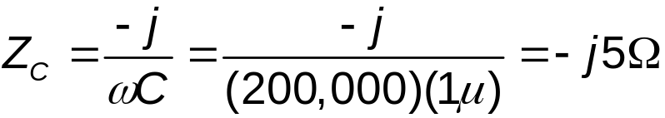
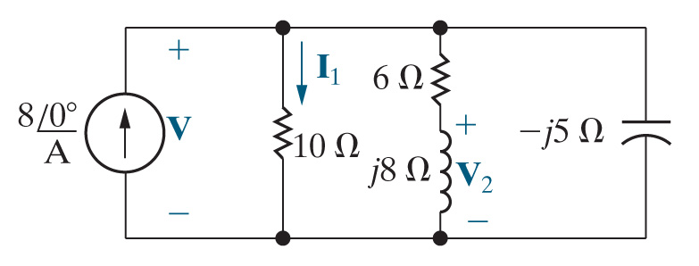
Chapter 9 – Sinusoidal Steady-State Analysis (6 of 17)
Example (continued):
Find v(t),
and
in the
steady-state.
Calculate the impedances of all resistors, inductors, and capacitors.

Slide 8
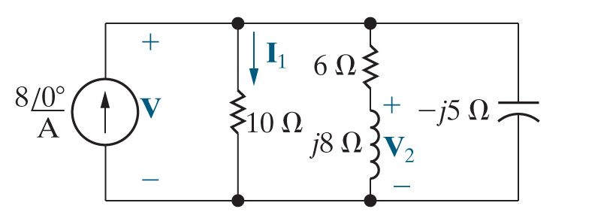
Chapter 9 – Sinusoidal Steady-State Analysis (7 of 17)
Example (continued):
Find v(t),
and
in the steady-state.
Use D C circuit analysis techniques to find the phasor V.
  In this problem, we’ll simplify the circuit by replacing all impedances by one equivalent impedance, and use Ohm’s law for phasors.

Slide 9
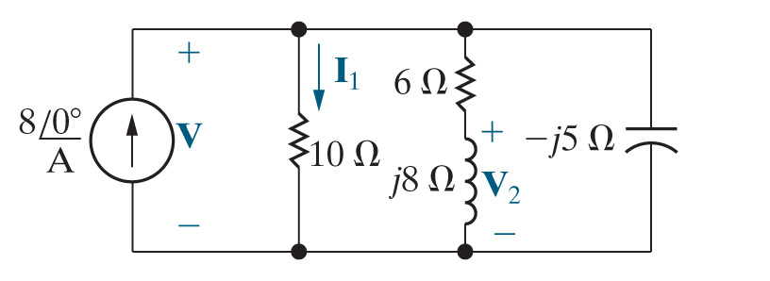
Chapter 9 – Sinusoidal Steady-State Analysis (8 of 17)
Example (continued):
Find v(t),
and
in the steady-state.
Inverse phasor-transform the result to get back to the time domain.

Slide 10

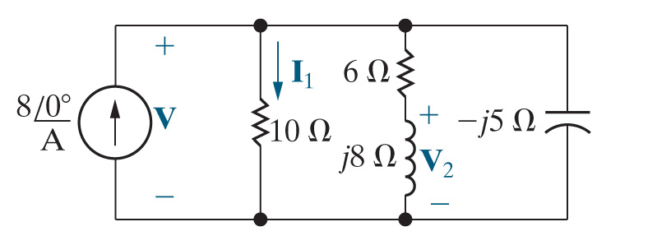
Chapter 9 – Sinusoidal Steady-State Analysis (9 of 17)
The most direct way to calculate the phasor
is
A. Voltage division
B. Current division
C. Source transform

Slide 11

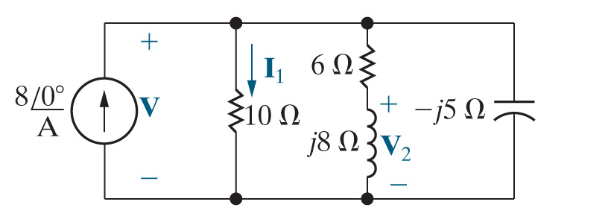
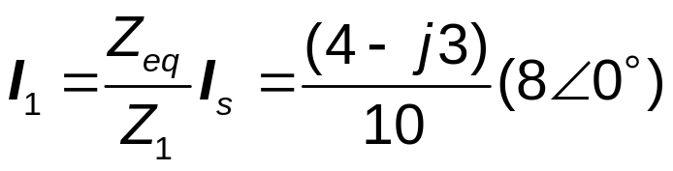

Sinusoid Steady-State Analysis
Example (continued):
Find v(t),
and
in the steady-state.
Use D C circuit analysis techniques to find the phasor
  Use current division.

Slide 12


Chapter 9 – Sinusoidal Steady-State Analysis (10 of 17)
Example (continued):
Find v(t),
and
in the steady-state.
Inverse phasor-transform the result to get back to the time domain.

Slide 13

Chapter 9 – Sinusoidal Steady-State Analysis (11 of 17)
The most direct way to calculate the phasor
is
A. Voltage division
B. Current division
C. Node voltage method

Slide 14

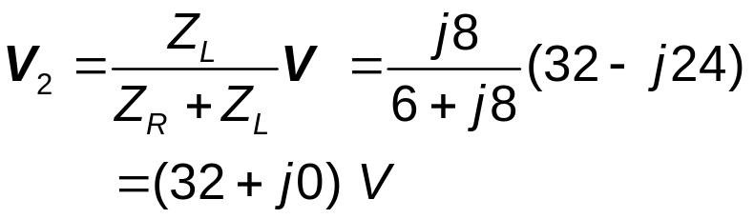
Chapter 9 – Sinusoidal Steady-State Analysis (12 of 17)
Example (continued):
Find v(t),
and
in the steady-state.
Use D C circuit analysis techniques to find the phasor
  Use voltage division.

Slide 15

Chapter 9 – Sinusoidal Steady-State Analysis (13 of 17)
Example (continued):
Find v(t),
and
in the steady-state.
Inverse phasor-transform the result to get back to the time domain.

Slide 16

Chapter 9 – Sinusoidal Steady-State Analysis (14 of 17)
Suppose we can vary the frequency of the current source.
What frequency will cause
and v(t) to be in-phase in the
steady-state?

Slide 17




Chapter 9 – Sinusoidal Steady-State Analysis (15 of 17)
If
and v(t) are in-phase in the steady-state, this means
A. Their phase angles are the same.
B. The equivalent impedance seen by the current
source has a phase angle of
C. The equivalent impedance seen by the current source is purely resistive.
D. All of the above.

Slide 18
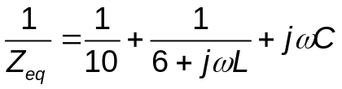
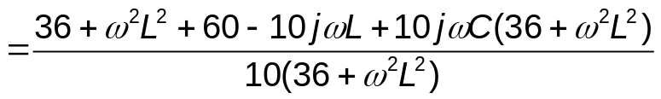
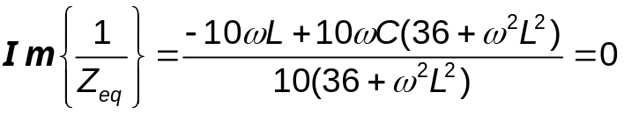

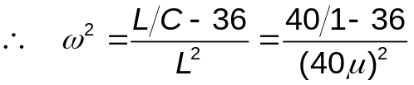

Chapter 9 – Sinusoidal Steady-State Analysis (16 of 17)
Notes:
Long Description 1:
equals Start Fraction Open Parenthesis 6 plus j omega L Close Parenthesis Open Parenthesis 6 minus j omega L Close Parenthesis over 10 Open Parenthesis 6 plus j omega L Close Parenthesis Open Parenthesis 6 minus j omega L Close Parenthesis End Fraction plus Start Fraction 10 Open Parenthesis 6 minus j omega L Close Parenthesis over 10 Open Parenthesis 6 plus j omega L Close Parenthesis Open Parenthesis 6 minus j omega L Close Parenthesis End Fraction plus Start Fraction 10 (j omega C) Open Parenthesis 6 plus j omega L Close Parenthesis Open Parenthesis 6 minus j omega L Close Parenthesis over 10 Open Parenthesis 6 plus j omega L Close Parenthesis Open Parenthesis 6 minus j omega L Close Parenthesis End Fraction.
Long Description 2:
equals Start Fraction 36 plus omega squared L squared plus 60 minus 10 j omega L plus 10 j omega C Open Parenthesis 36 plus omega squared L squared Close Parenthesis over 10 Open Parenthesis 36 plus omega squared L squared Close Parenthesis End Fraction.
Long Description 3:
I m Open CurlyBracket Start Fraction 1 over Z subscript e q BaseLine End Fraction Close CurlyBracket equals Start Fraction negative 10 omega L plus 10 omega C Open Parenthesis 36 plus omega squared L squared Close Parenthesis over 10 Open Parenthesis 36 plus omega squared L squared Close Parenthesis End Fraction equals 0.

Slide 19
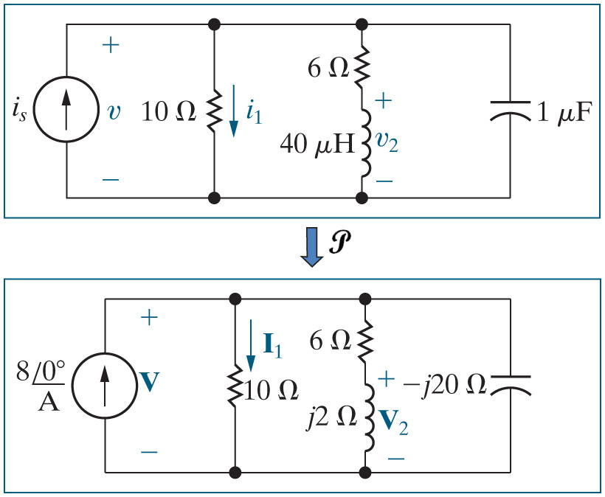


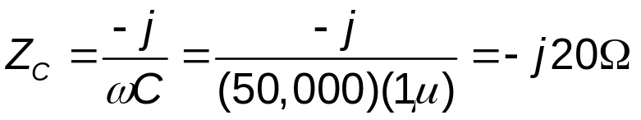

Chapter 9 – Sinusoidal Steady-State Analysis (17 of 17)
Suppose we can vary the frequency of the current source.
What frequency will cause
and v(t) to be in-phase in the
steady-state?
For

Slide 20

Copyright
This work is protected by United Kingdom copyright laws and is provided solely for the use of instructors in teaching their courses and assessing student learning. Dissemination or sale of any part of this work (including on the World Wide Web) will destroy the integrity of the work and is not permitted. The work and materials from it should never be made available to students except by instructors using the accompanying text in their classes. All recipients of this work are expected to abide by these restrictions and to honor the intended pedagogical purposes and the needs of other instructors who rely on these materials.

